Slide 1
Dimensionality Reduction

Slide 2
Dimensionality Reduction
Curse of dimensionality:
irrelevant features
redundant features
These irrelevant and redundant features may confuse learner incase of limited training examples, as it leads to overfitting.
To overcome curse of dimensionality: Feature Reduction

Slide 3
Importance
A lower number of dimensions in data means less training time and less computational resources
Dimensionality reduction avoids the problem of overfitting
Dimensionality reduction is extremely useful for data visualization
Dimensionality reduction takes care of multicollinearity
Dimensionality reduction can be used for image compression
Dimensionality reduction can be used to transform non-linear data into a linearly-separable form : (read Kernel PCA)

Slide 4
Dimensionality Reduction Methods
Dimensionality Reduction
Feature Selection
Feature Extraction

Slide 5
Feature Selection
Selects a subset of features from the original dataset.
Method of Feature Selection:
Selecting uncorrelated features
Eliminate irrelevant features

Slide 6
Feature Selection
Univariate methods: (looks at each feature independently of other features)
Pearson correlation coefficient
F-score
Chi-square, etc
Multivariate methods: (consider all features simultaneously)
Backward Elimination
Forward Selection
Random Forests

Slide 7
Feature Extraction
Uncorrelated features Extraction
Uncorrelated features are extracted
Linear Methods
PCA
LDA
SVD
FA
Non-Linear Methods
Kernel – PCA
t-SNE
MDS
Isomap

Slide 8
Principal Component Analysis

Slide 9
Principal Component Analysis
PCA is an orthogonal linear transformation that transfers the data to a new coordinate system.
Greatest variance by any projection of the data comes to lie on the first coordinate (first principal component), the second greatest variance lies on the second coordinate (second principal component), and so on.

Slide 10
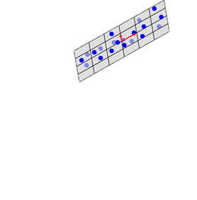
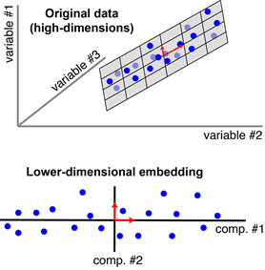
Principal Component Analysis
Variable #1
Variable #2
a). Original data (high - dimensions)
b). Lower dimensional embedding

Slide 11
Steps for Computing PCA
Standardization of the data
Computing the covariance matrix
Calculating the eigenvectors and eigenvalues
Computing the Principal Components
Reducing the dimensions of the data set

Slide 12


Step1: Standardization of data
Scaling the data in such a way that all the features and their values lie within a similar range.
It is calculated as:
$$Z=\frac{feature value −mean}{standard deviation}$$

Slide 13
Step2: Computing the covariance matrix
Covariance matrix expresses the correlation between the different features in the data set.
essential to identify heavily dependent features because they contain biased and redundant information which reduces the overall performance of the model.

Slide 14
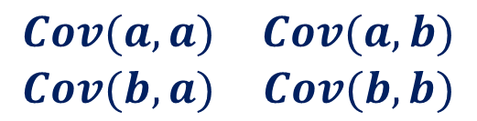
Step2: Computing the covariance matrix contd.
Mathematically a covariance matrix can be written as:
C^{nxn} = (c_{i,j}), where c_{i,j} = cov(A_{i} , A_{j})
2-Dimensional data set with features a and b, the covariance matrix is a 2×2 matrix as shown below:
$$\begin{matrix}Cov(a,a) & Cov(a,b) \\ Cov(b,a) & Cov(b,b)\end{matrix}$$
Notes:
Cov(a, a) represents the covariance of a variable with itself, which is nothing but the variance of the variable ‘a’
Cov(a, b) represents the covariance of the variable ‘a’ with respect to the variable ‘b’. And since covariance is commutative, Cov(a, b) = Cov(b, a)

Slide 15
Step3: Calculating Eigenvectors and Eigenvalues
Eigenvectors are orthogonal vectors that define a space, the Eigenspace.
Any data point can be described as a linear combination of Eigenvectors.

Slide 16

Step3: Calculating Eigenvectors and Eigenvalues
Eigenvectors of a square matrix have the following property:
$$A\vec{v}=λ\vec{v}$$
The $λ$ is the eigenvalue.
Eigenvectors of a covariance matrix represents the direction of variance.
Eigenvalues represents the degree of the variance.
Solve the following characteristic equation to calculate the eigenvalues:
det (I-A) = 0
The eigenvectors can be calculated as: (I-A)v= 0

Slide 17
Step4: Choosing Principal Components
Order the eigenvectors by the eigenvalues, highest to lowest. This gives you the components in order of significance.
Now, if you like, you can decide to ignore the components of lesser significance. You do lose some information, but if the eigenvalues are small, you don’t lose much.
Form a feature vector by taking the eigenvectors that you want to keep from the list of eigenvectors, and form a matrix with these eigenvectors in the columns.
Feature Vector = ( eig₁, eig₂,……, eig_{n})

Slide 18
Step5: Reducing the Dimensions
Choose the components (eigenvectors) that you wish to keep in our data and formed a feature vector, simply take the transpose of the vector and multiply it on the left of the original data set, transposed.
Final Data = (Feature Vector)^{T} * Data Set

Slide 19
Thank You

